Slide 1


Training about ESP32-C5
Content
Background
Prepare
Peripheral
How to build code & Apply

Slide 2
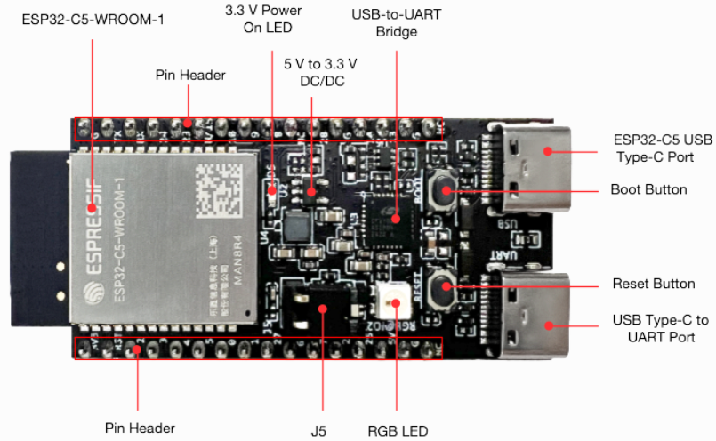
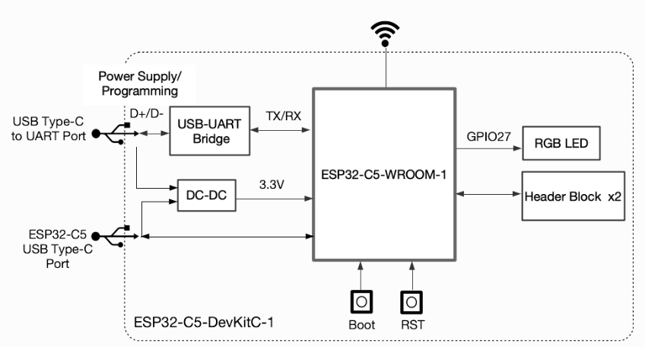
Background
Introduce ESP32-C5
ESP32-C5 is a system on a chip that integrates the following features:
Wi-Fi (2.4 GHz band & 5 GHz )
Bluetooth
Dual high performance Xtensa® 32-bit LX6 CPU cores
Ultra Low Power co-processor
Multiple peripherals

Slide 3
Background
Advantage of ESP32-C5
Dual-Band Wi-Fi 6 Support (2.4 GHz & 5 GHz)
Supports Wi-Fi 6 and both bands (2.4 GHz & 5 GHz).
This makes the network more stable, less speed.
Multiple protocol connections
In addition to Wi-Fi, there is also Bluetooth 5 and Zigbee/Thread/Matter support → suitable for smart factory.
Good activation
Uses 32-bit RISC-V core, speed up to 240 MHz, fast and stable processing.
Rich Peripheral Support
Up to 29 GPIOs, plus interfaces like SPI, I2C, I2S, UART, PWM, and USB OTG.
Supports external PSRAM for memory expansion.
5. Open-Source SDK & Ecosystem
Fully supported by ESP-IDF, ensuring easy migration and integration with existing ESP32 projects. Arduino support is also in development

Slide 4

Prepare
Software need install:
Adruino IDE: coding, edit, debug, and build software applications
Knowledge:
Basic about C/C++
Hardware/ firmware
Peripheral
Wireless communication network

Slide 5
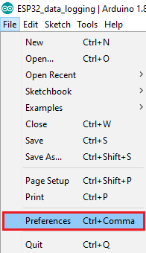
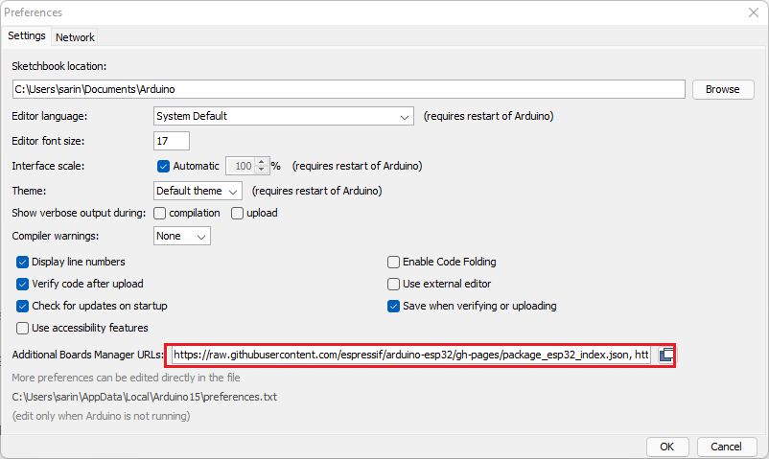
Prepare
Setup board ESP32-C5
1. In your Arduino IDE, go to File> Preferences
2. Enter the following into the “Additional Board Manager URLs” field:
https://raw.githubusercontent.com/espressif/arduino-esp32/ghpages/package_esp32_index.json

Slide 6
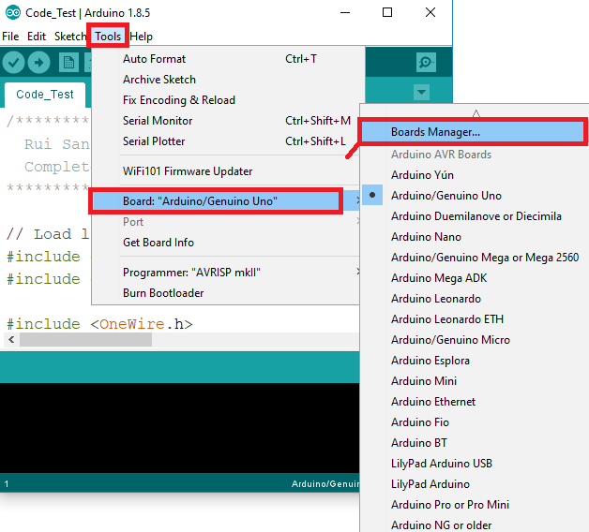
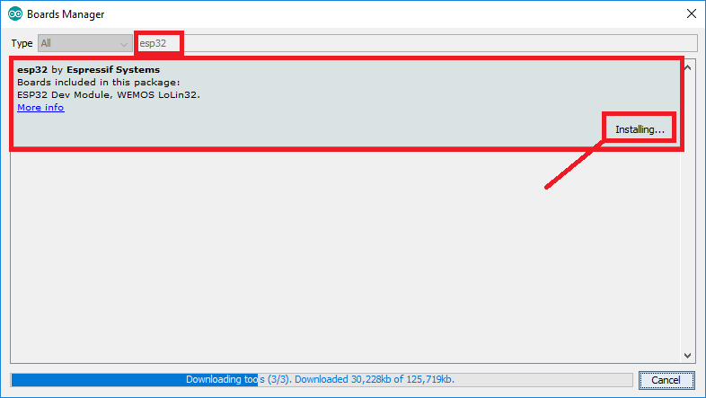
Prepare
Setup board ESP32-C5
3. Open the Boards Manager. Go to Tools > Board > Boards Manager…
4. Search for ESP32 and press install button for the “ESP32 by Espressif Systems“:

Slide 7
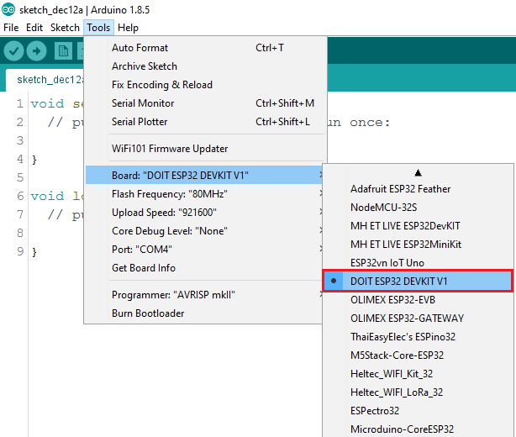
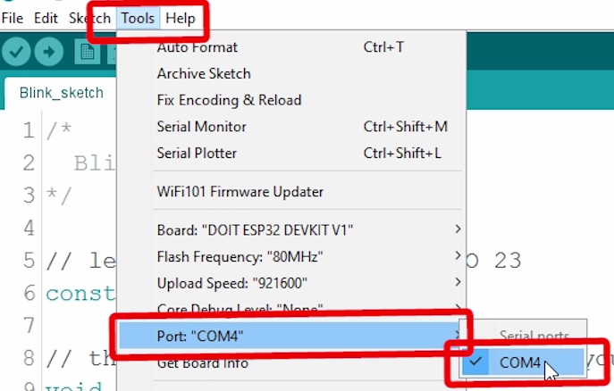
Prepare
Setup board ESP32-C5
Select your Board in Tools > Board menu (in my case it’s the DOIT ESP32-C5)
Select your Board
DOIT ESP32-C5

Slide 8
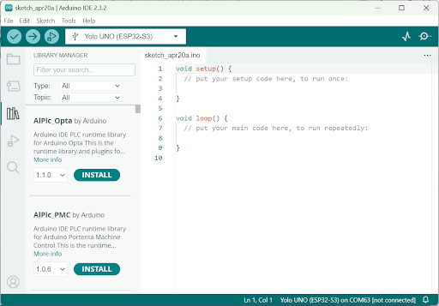
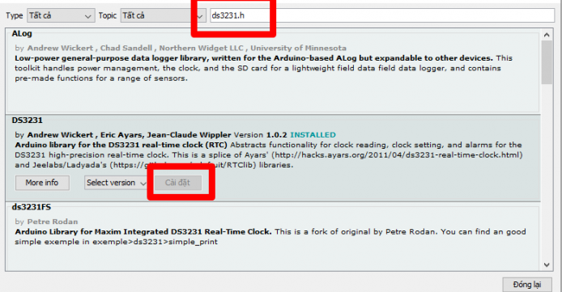
Prepare
How to install library
Install manufacturer’s library
For example
2.Input
2.Input
1
3
3
3

Slide 9
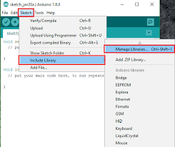
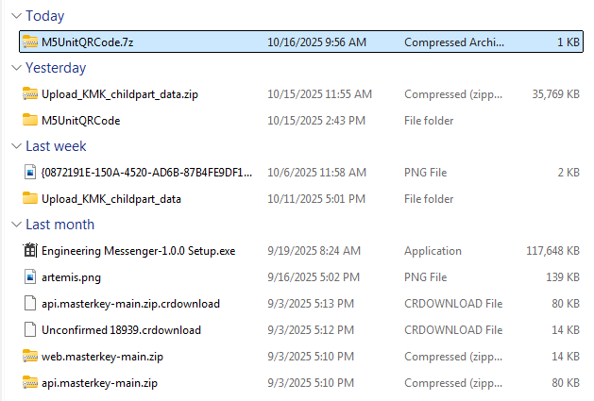
Prepare
How to install library
Install other peripheral libraries
If you cannot find the desired library in the library manager, you can do the following:
Install peripheral libraries
Add library to AdruinoIDE:
Choose file to add library

Slide 10
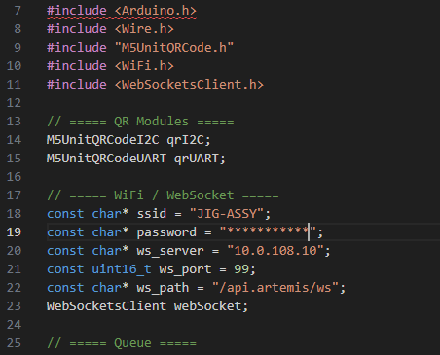
10
Prepare
Declare required libraries
After installing the library, you need to declare the library to use it.

Slide 11
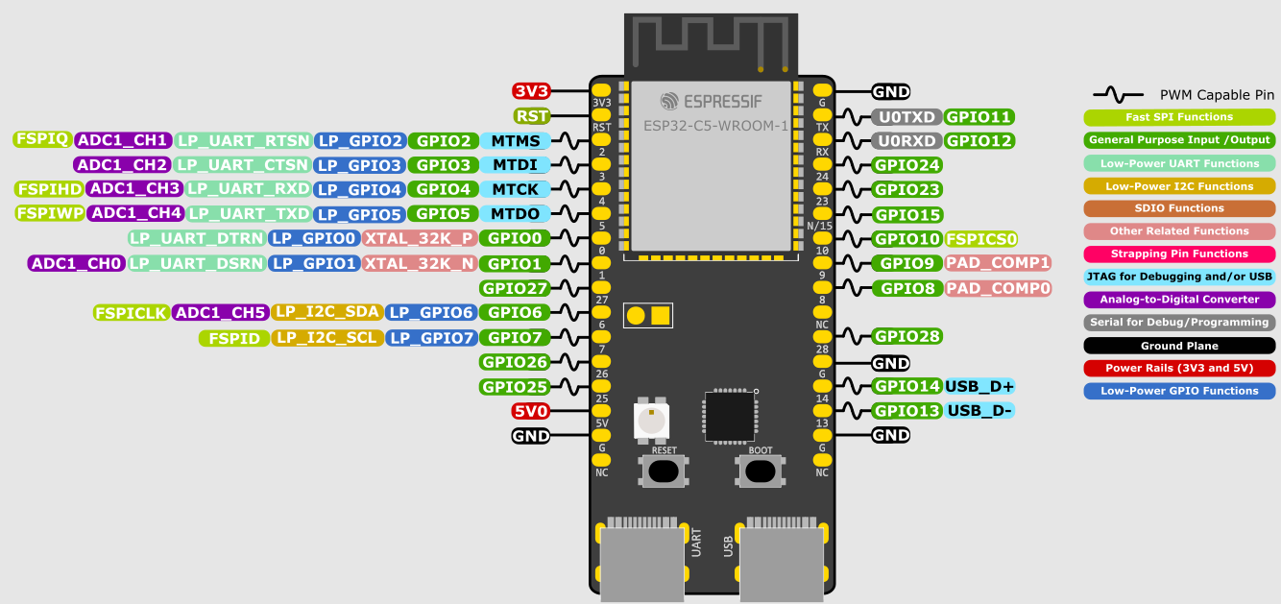
11
Peripheral
Overview
The ESP32-C5 module has multiple pins (GPIOs) that can perform different functions. These pins are color-coded in the diagram for easy understanding:

Slide 12
12
Peripheral
Overview
General GPIO (Green)
These are basic input/output pins.
You can use them to read signals (like from a button) or send signals (like turning on an LED).
Many of them support PWM for controlling brightness or motor speed.
Communication Interfaces
UART (Purple): For serial communication with other devices (e.g., sensors, GPS).
SPI (Light Green): High-speed communication with displays or memory chips.
I2C (Yellow): Commonly used for sensors and small modules.
3. ADC (Pink)
Analog-to-Digital Converter pins.
Used to read analog signals (e.g., from a temperature sensor or potentiometer).
USB & Debug
USB D+ / D- (Blue): For programming and USB communication.
JTAG (Green): For advanced debugging.
Special Functions
PAD_COMP (Red): Comparator-related functions.
XTAL: Crystal oscillator pins for clock.
Power
Pins3V3 and GND: Power supply for the board.

Slide 13
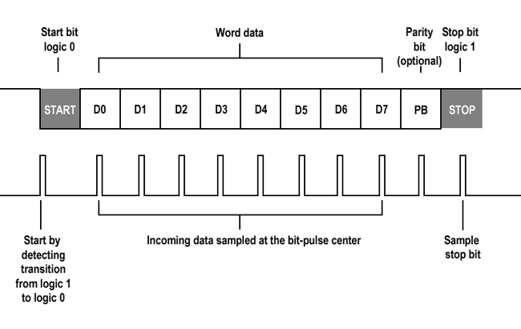
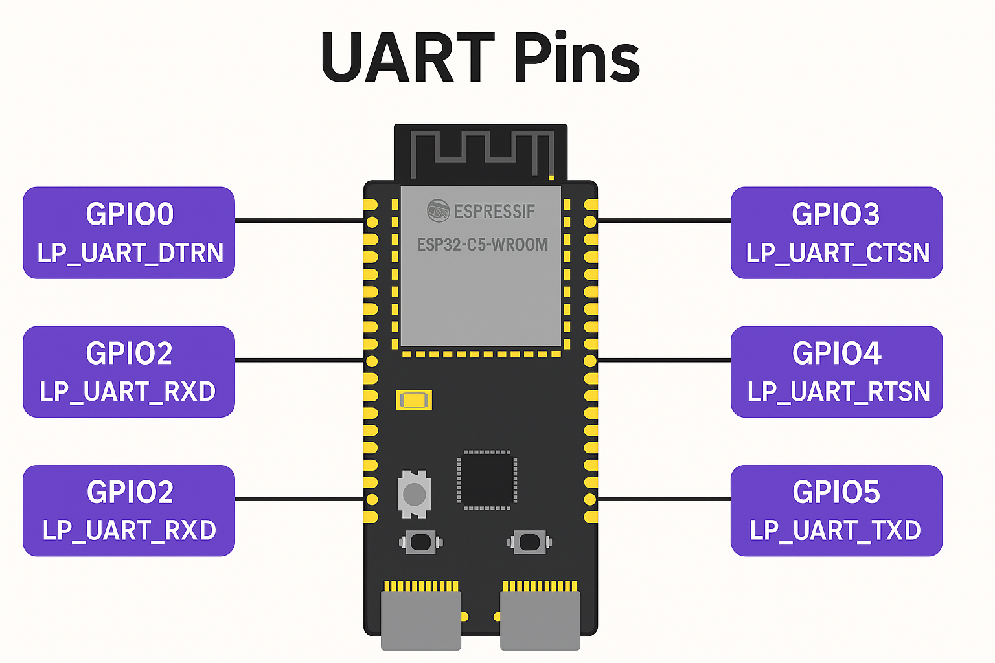
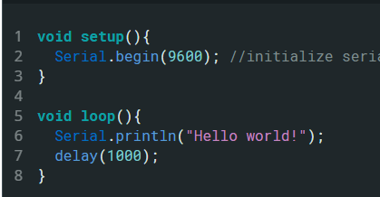
13
Peripheral
UART communication
UART is an asynchronous communication, meaning it does not have a dedicated clock line.
Both devices must agree on the baud rate to properly interpret the data.
Data is sampled between each bit to avoid noise.
Set up baud rate depending on the baud rate of the peripheral
For example

Slide 14
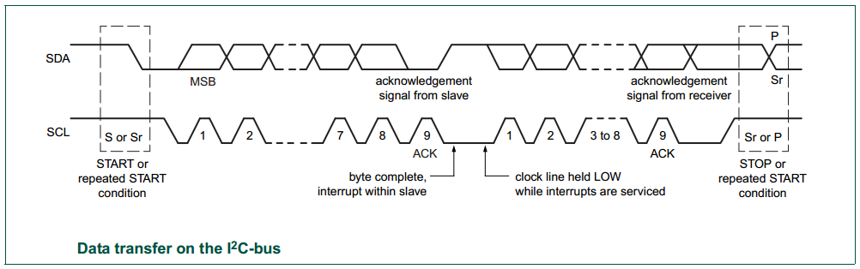
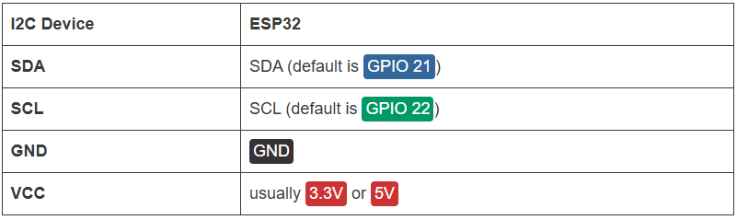
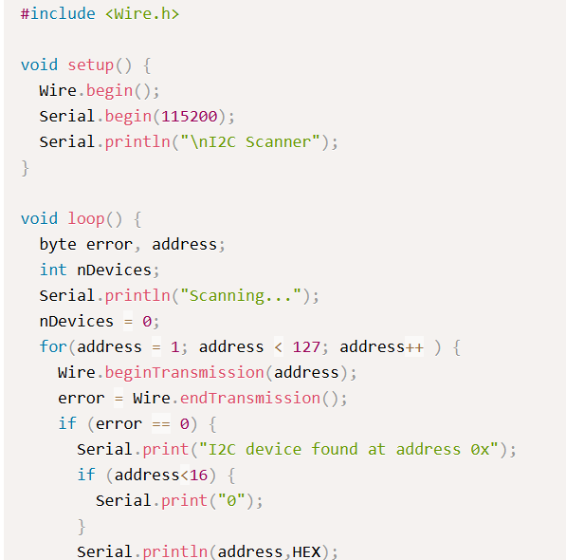
14
Peripheral
I2C communication
I2C communication protocol uses two wires to share information. One is used for the clock signal (SCL) and the other is used to send and receive data (SDA).
For example
Declare I2C’s library
Call I2C’s library
When using the ESP32 with Arduino IDE, the default I2C pins are (SCL) and (SDA) but you can configure your code to use any other pins.

Slide 15
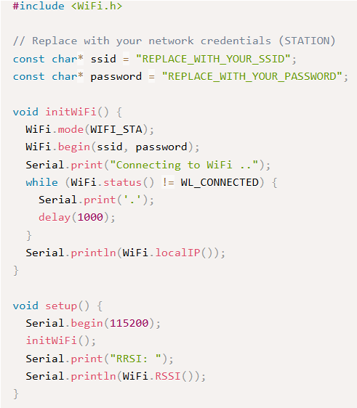
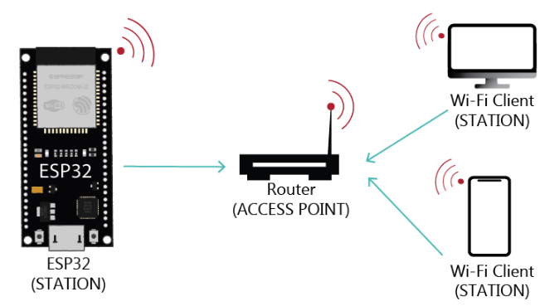
15
Peripheral
For example
Declare Wi-Fi’s library
Wi-Fi
Input Wi-Fi account
When the ESP32 is set as a Wi-Fi station, it can connect to other networks (like your router). In this scenario, the router assigns a unique IP address to your ESP board. You can communicate with the ESP using other devices (stations) that are also connected to the same network by referring to the ESP unique IP address.
Wi-Fi environment connection function
Call function

Slide 16
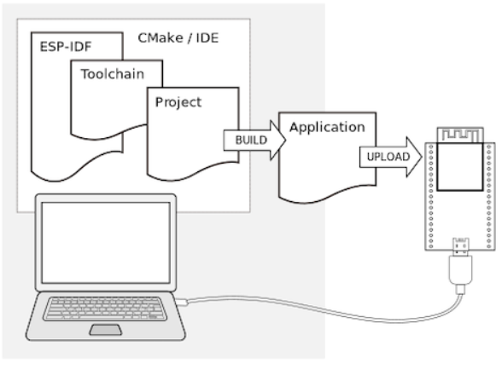
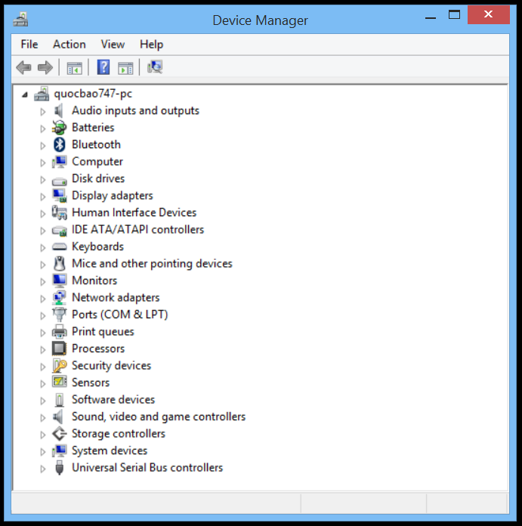
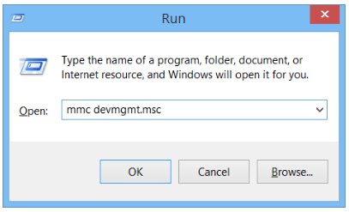
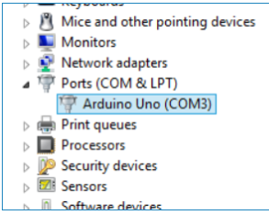
How to build code
Set up hardware
Step 1: Connect ESP32-C5 to PC
Step 2: Find the connection port of ESP32-C5 to the PC
You open the Run window and type the command “mmc devmgmt.msc”.
ESP32 (COM4)
ENTER
Notes:
https://raw.githubusercontent.com/espressif/arduino-esp32/gh-pages/package_esp32_index.json

Slide 17
How to build code
Set up hardware
Step3: Go to menu Tools -> Serial Port -> select the Arduino port connected to the computer.
Notes:
https://raw.githubusercontent.com/espressif/arduino-esp32/gh-pages/package_esp32_index.json

Slide 18
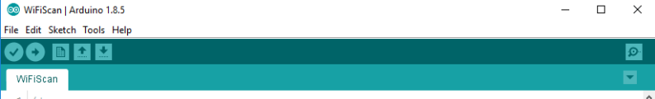
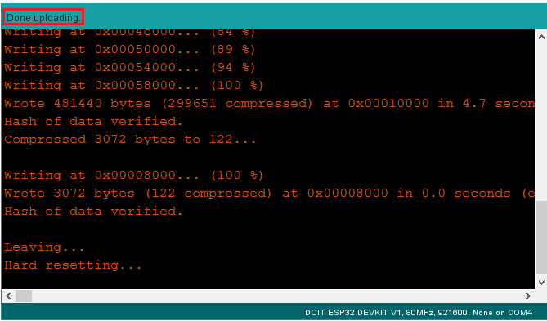
How to build code
Build code
Press the Upload button in the Arduino IDE. Wait a few seconds while the code compiles and uploads to your board.
2. Press the ESP32 on-board Enable button and you should see the networks available near your ESP32:
Serial Moniter
Upload successful notification
Upload code
Notes:
https://raw.githubusercontent.com/espressif/arduino-esp32/gh-pages/package_esp32_index.json

Slide 19
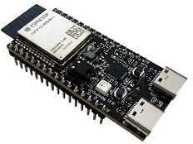



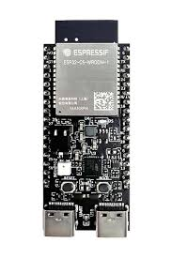
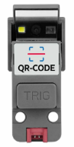
Apply
Express.js, or simply Express, is a back end web application framework for building RESTful APIs with Node.js
Artemis
Frontend
Backend
Hardware
PIN 2
SDA
PIN 3
SCL
5V
5V
GND
GND
Artemis is a system that scans QR code and sends data to the system in real time
Notes:
Using Raspberry as a 5Ghz Wifi Connection Intermediary

Slide 20
Apply
Start creating embedded using Esp32-c5 + Unit QR Code
Create project Adruino
Create folder project
Install M5UnitQRCode library
Link install: https://github.com/m5stack/M5Unit-QRCode
3. Add library to AdruinoIDE:
Choose file to add library
Notes:
Choose to use the ESP32 OR Bride ESPNOW method
Test directly at the production site to check for interference

Slide 21
21
21
Apply
Import library neccessary
Arduino.h:This is the core library of Arduino, providing the most basic functions and constants for programming on the platform.
Wire.h:This library allows communication with devices using the I2C (Inter-Integrated Circuit) protocol.
M5UnitQRCode.h:This is a library specifically for the M5Stack UNIT QRCode module. This module is often used to read and decode QR codes.
WiFi.h:This library is used to connect the ESP32 module (or WiFi capable modules) to the wireless network.
WebSocketsClient.h: This library provides the ability to connect devices to a WebSocket server.
Notes:
This library provides the ability to connect devices to a WebSocket server.

Slide 22
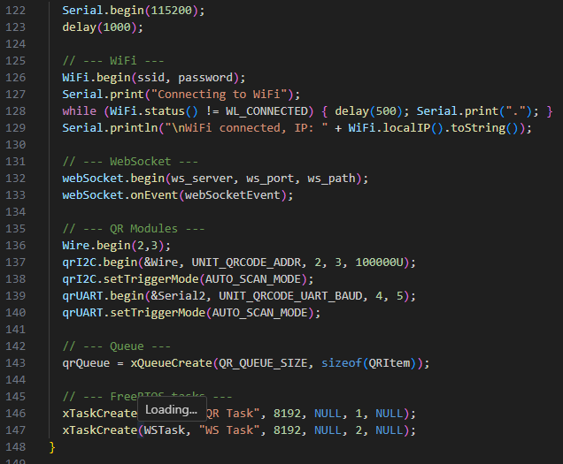
22
Apply
Set up object
Set up Buadrate
Set up connect Wifi
Set up UnitQRCode
Set up FreeRTOS

Slide 23
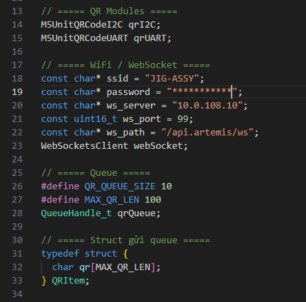
23
Apply
Define object
Declare and create objects (variables) to represent the QR code scanning module
Declares the constants and an object needed so that the ESP32 can connect to a Wi-Fi network and then establish a WebSocket connection with a specific server.
The use of real-time operating system (RTOS) FreeRTOS, built into ESP32 microcontrollers, to manage and process QR code data effectively and safely.
Defines a structure named QRItem to contain the data of a QR code. This structure will then be used as the data type for the elements in the FreeRTOS queue.
Notes:
Defines a structure named QRItem to contain the data of a QR code. This structure will then be used as the data type for the elements in the FreeRTOS queue.

Slide 24
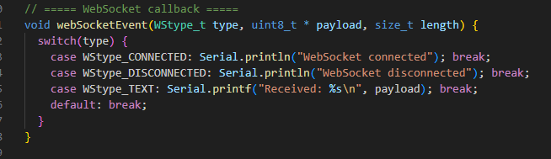
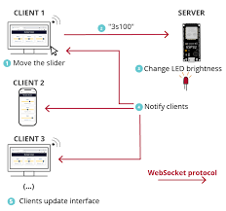
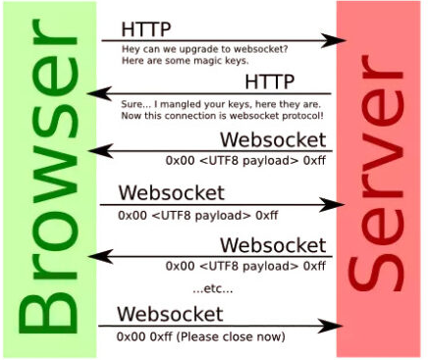
24
Apply
WebSocket callback
The webSocketEvent function is an event handler registered with the WebSocketsClient library to listen and react to various events that occur during WebSocket communication.
Notes:
The webSocketEvent function is an event handler registered with the WebSocketsClient library to listen and react to various events that occur during WebSocket communication.

Slide 25
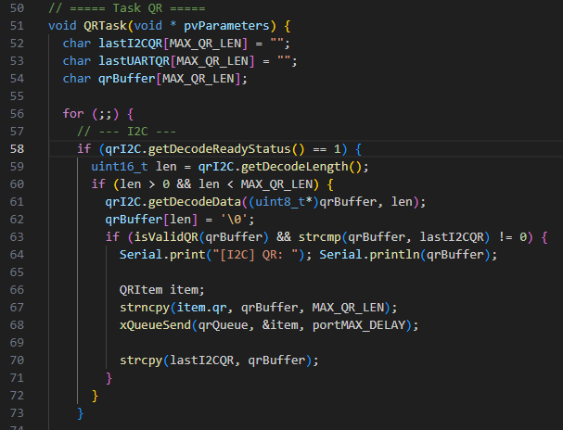
25
Apply
Task scan QR Code of FreeRTOS
Create variables to store data
Retrieve and perform data processing
Notes:
Retrieve and perform data processing

Slide 26
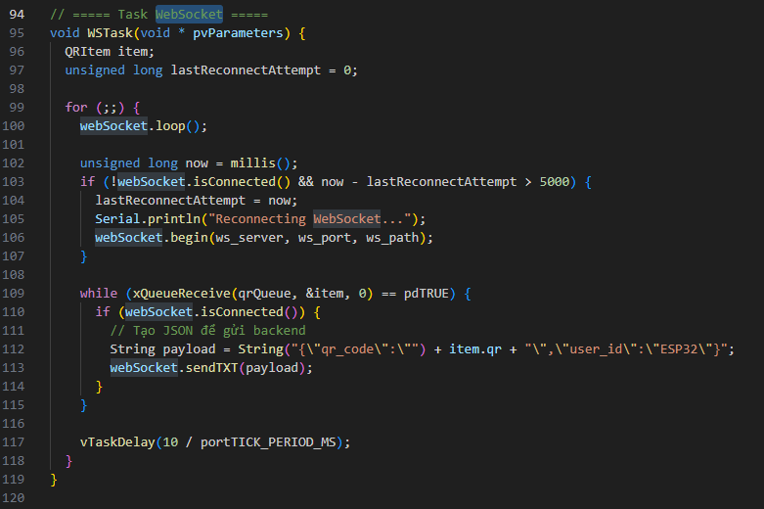
26
Apply
Task Websocket of FreeRTOS
Initial declaration for the task (Task) that handles WebSocket communication (named WSTask)
Check connect with Websocket
Send data to back end
Notes:
initial declaration for the task (Task) that handles WebSocket communication (named WSTask)

Slide 27
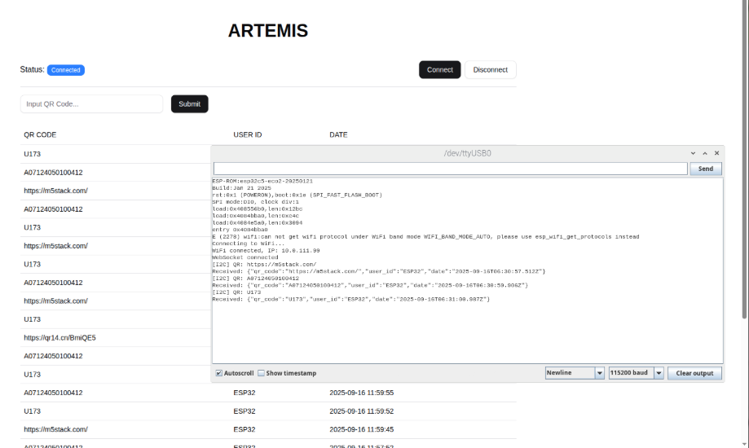
27
Apply
Result
Link project: Artemis_esp32/esp32_C5 at main - Artemis_esp32 - Gitea: Git with a cup of tea
Render to interface
Notes:
Render to interface

Slide 28


Slide 29
1. What is a key advantage of ESP32-C5?
A. Only supports 2.4 GHz Wi-Fi
B. Supports Wi-Fi 6 dual-band (2.4 & 5 GHz)
C. Does not support Bluetooth
Correct Answer: B
2. What type of communication is UART on ESP32-C5?
A. Synchronous with clock line
B. Asynchronous without clock line
C. Only for USB
Correct Answer: B
4. What is the main purpose of GPIO pins?
A. Debugging only
B. General input/output for signals
C. Power supply
Correct Answer: B
5. Which library is used for Wi-Fi in Arduino for ESP32?
A. Wire.h
B. WiFi.h
C. WebSocketsClient.h
Correct Answer: B
3. In I2C, what do SDA and SCL do?
A. SDA sends data, SCL provides clock
B. SDA provides clock, SCL sends data
C. Both send data
Correct Answer: A

